Slide 1
Introduction to Bayesian Statistics
Foo Lee Kien (PhD)

Slide 2
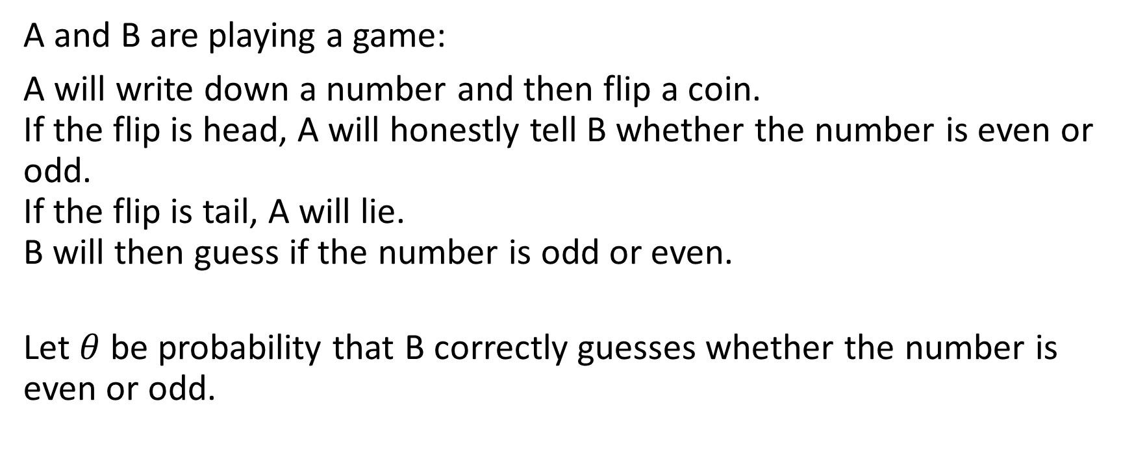
Motivating Example
A and B are playing a game:
A will write down a number and then flip a coin. If the flip is head, A will honestly tell B whether the number is even or odd. If the flip is tail, A will lie. B will then guess if the number is odd or even.
Let $θ$ be probability that B correctly guesses whether the number is even or odd.

Slide 3

Motivating Example
Before A and B start their game
What’s your best guess about $θ$?
2. What’s the probability that $θ$ is greater than half?

Slide 4
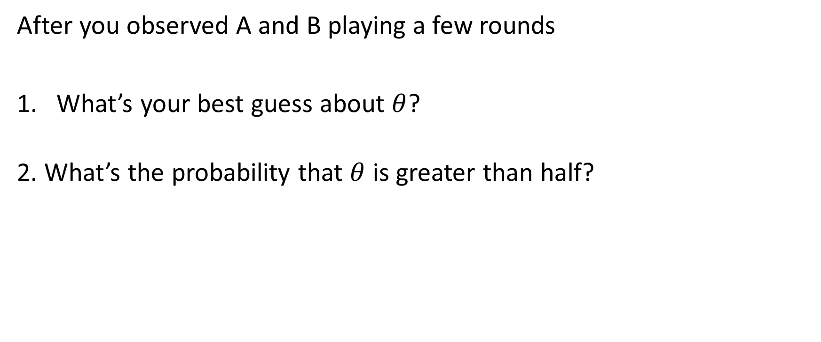
Motivating Example
After you observed A and B playing a few rounds
What’s your best guess about $θ$?
2. What’s the probability that $θ$ is greater than half?

Slide 5
Motivating Example (After lunch)
Hypothetical Situation:
Assume that a patient enters your clinic, and her test results for a rare disease is positive.
Would you suggest an expensive treatment?
What do you need to know for an informed decision?

Slide 6
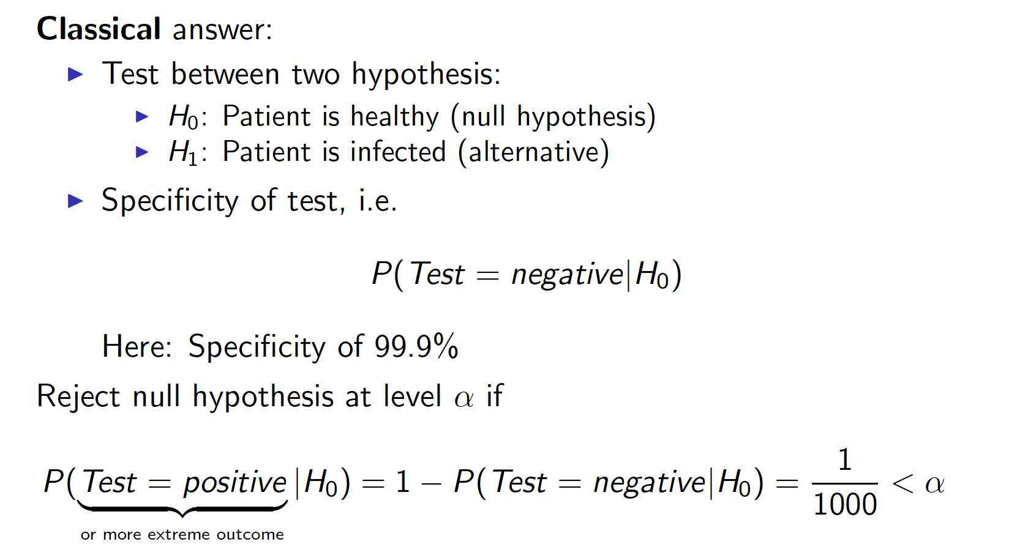
Motivating Example

Slide 7
Bayesian Answer

Slide 8
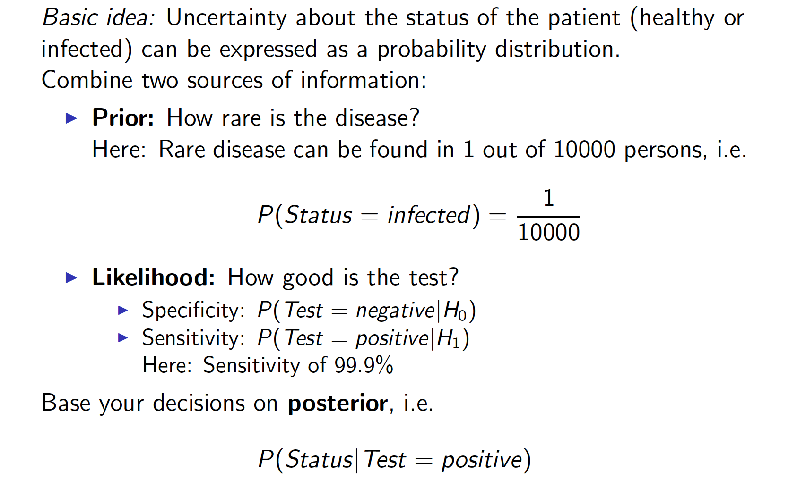
Motivating Example

Slide 9
Contents
Frequentist Approach
Bayesian Approach
Review on Probability
Bayesian Inference

Slide 10
Frequentist Approach

Slide 11
Frequentist Approach
Assumed a hypothetical infinite sequence of events.
Look at the relevant frequency.
Example:
P(getting a head when toss a fair coin)

Slide 12
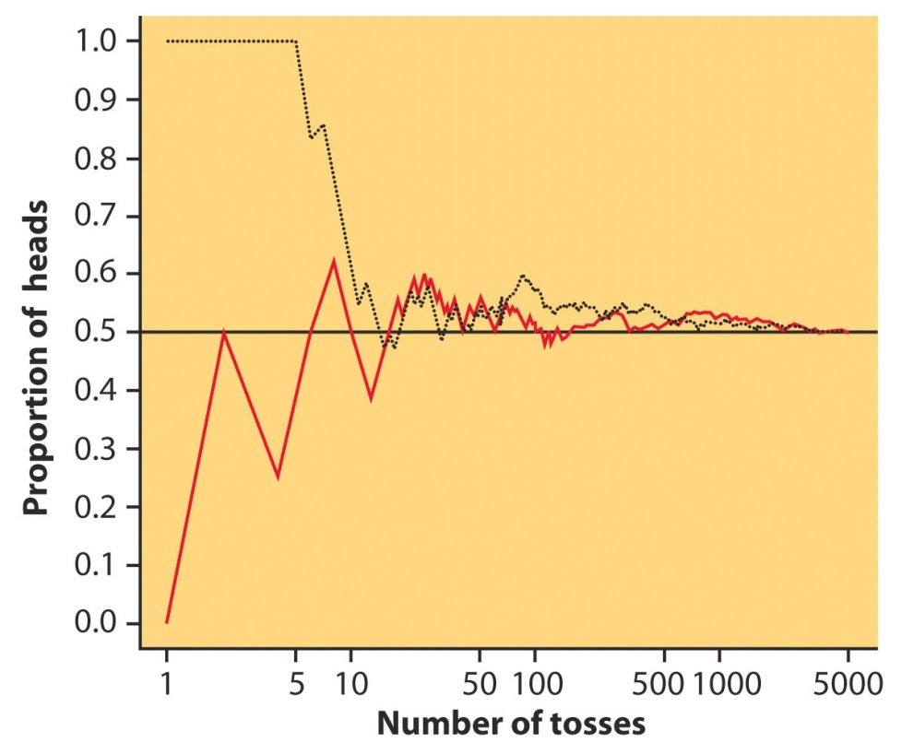
Example
P(getting a head when toss a fair coin)
No of tosses | No of heads
10 | 3
100 | 51
500 | 249
1000 | 503
5000 | 2521
10000 | 5067
50000 | 25101
Approaches 0.5

Slide 13
Example
P(getting a head when toss a fair coin)
No of tosses | No of heads
10 | 3
100 | 51
500 | 249
1000 | 503
5000 | 2521
10000 | 5067
50000 | 25101
What is the apparent problem here?

Slide 14
Example
P(getting a head when toss a fair coin)
No of tosses | No of heads
10 | 3
100 | 51
500 | 249
1000 | 503
5000 | 2521
10000 | 5067
50000 | 25101
Dependency on the number of times the trials were run!

Slide 15
Frequentist Approach
To test whether an event occurs or not, it calculates the probability of an event in the long run of an experiment.
p-value
Confidence Interval

Slide 16
Recap on Sampling Distribution
Klout score example
Load the data in Jupyter Notebook with Pandas
Get the Mean and Std Deviation

Slide 17
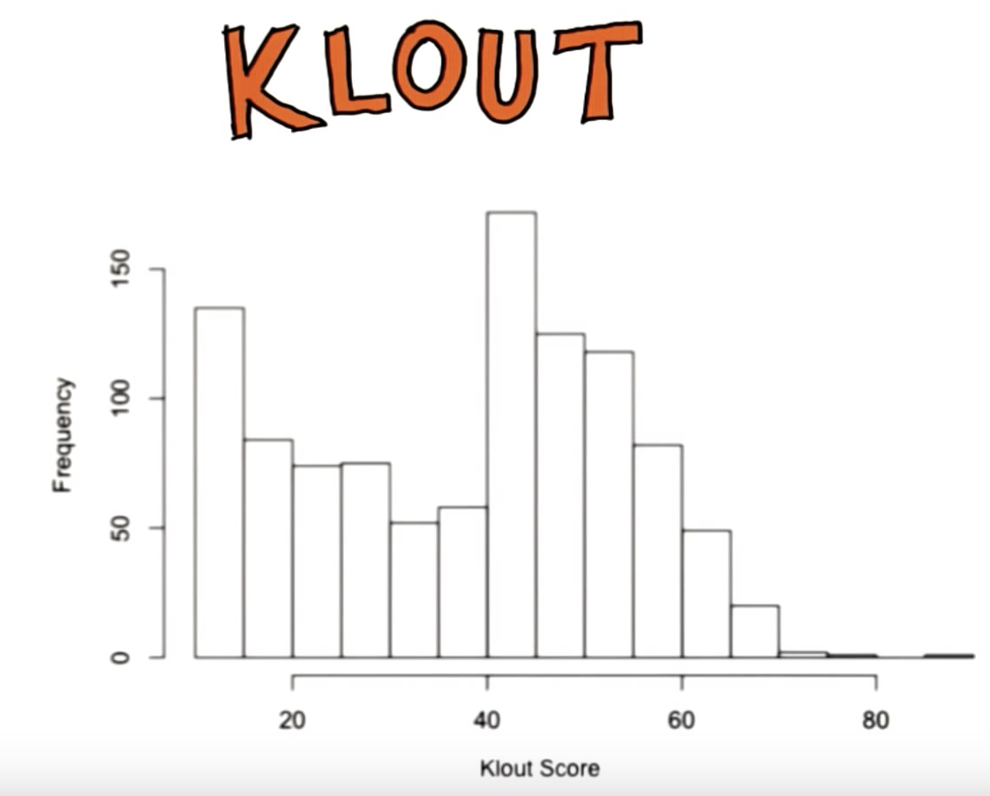
Standard Deviation:
Mean:

Slide 18
Take samples of size 35.
Find
Mean of samples:
Std Dev:

Slide 19
Take samples of size 35.
People who use Bieber Twitter has score of 40
Find
Z-score of 40:
The probability of obtaining at least 40:

Slide 20
Now, increase sample size to 250.
Find
Standard Deviation:
Z-score for 40:
Probability of obtaining at least 40:

Slide 21
What can you conclude?
Heavily dependent on sample size
P-value changes with sample size
The bigger the sample size, the smaller the confidence interval

Slide 22
Bayesian Approach

Slide 23
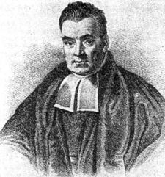
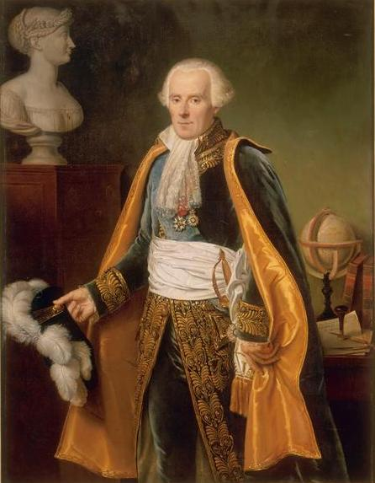
Thomas Bayes (1702 –1761)
Pierre-Simon Laplace
(1749–1827)

Slide 24
Bayesian Approach
Subjective approach to probability.
Allows us to reason about our beliefs under conditions of uncertainty.
Provides the tools to update our beliefs in the evidence of new data.
Under the subjective or “degrees of belief” definition of probability, we can ask question such as:
What is the probability that Malaysia will rank number 1 in the 2017 SEA game?

Slide 25
Bayesian Approach
Better to use it when
Data is limited
We are worried about overfitting
We have a reason to believe that some facts are more likely than others, but this information is not contained in the data we model on
We are interested in precisely knowing how likely certain facts are, as opposed to just picking the most likely fact

Slide 26

Example
Suppose, out of all the 4 marathon races between 2 players, A and B, A won 3 times while B won only 1.
There is a coming race, which player would you bet your money on?

Slide 27
Example
What if you are told that it rained once when B won and once when A won and it is definitely going to rain on the next marathon race.
So, which player would you bet your money on now?
WE WILL COME BACK TO THIS LATER…

Slide 28
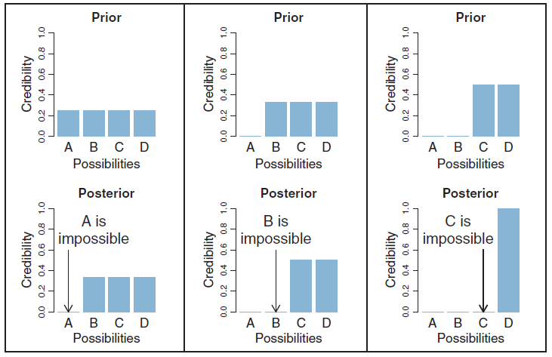
Bayesian Approach

Slide 29
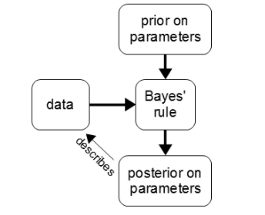
Bayesian Approach

Slide 30
Review on Probability

Slide 31

Axioms of Probability
0 $≤$ P(A) $≤$ 1
Certainty: P(A) = 1
Impossible: P(A) = 0
Uncertainty: 0 < P(A) < 1

Slide 32
Examples
P(get a 4 when roll a die)
P(get a tail when toss a coin)
P(get the sum of 4 when roll a die two times)

Slide 33
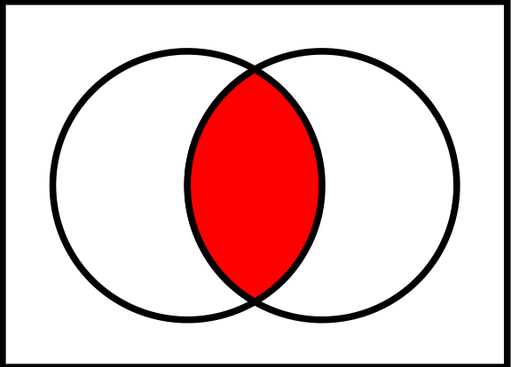

Joint Probability
Probability that two events, say A and B, are both true.
P(A$∩$B)
P(A$∪$B) = P(A) + P(B) – P(A$∩$B)

Slide 34
Example
Assume that the engine component of a spacecraft consists of two engines in parallel. If the main engine is 95% reliable (M), the backup is 80% reliable (B), and the engine component as a whole is 99% reliable, what is the probability that both engines will be operable?

Slide 35

Conditional Probability
Probability based on some background information.
P(A|B): probability of A given that B is true.
P(A|B) = $\frac{P(A∩B)}{P(B)}$

Slide 36
Example
In studying the causes of power failures, these data have been gathered. 5% are due to transformer damage (T), 80% are due to line damage (L) and 1% involve both problems. Based on these percentages, what is the probability that a power failure involves line damage given that there is transformer damage.

Slide 37
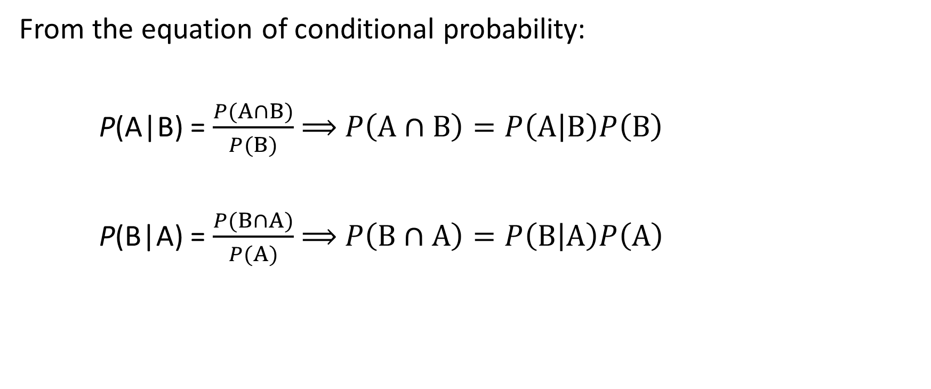
More on Conditional Probability
From the equation of conditional probability:
P(A|B) = $\frac{P(A∩B)}{P(B)}$ $⟹$ $P\left(A∩B\right)=P\left(A | B\right)P\left(B\right)$
P(B|A) = $\frac{P(B∩A)}{P(A)}$ $⟹$ $P\left(B∩A\right)=P\left(B | A\right)P\left(A\right)$

Slide 38

Bayes Theorem
$P\left(A∩B\right)=P\left(A | B\right)P\left(B\right)$ and $P\left(B∩A\right)=P\left(B | A\right)P\left(A\right)$
$P\left(A∩B\right)$ $=$ $P\left(B∩A\right)$
$P\left(A | B\right)P\left(B\right)$ $=$ $P\left(B | A\right)P\left(A\right)$
$P\left(A | B\right)= \frac{P(B|A)P(A)}{P(B)}$

Slide 39
Example
There are two bowls of cookies. Bowl 1 contains 30 vanilla cookies and 10 chocolate cookies. Bowl 2 contains 20 of each. Now suppose you choose one of the bowls at random and, without looking, select a cookie at random. The cookie is vanilla (V). What is the probability that it came from Bowl 1 (B1)?

Slide 40
Practice Questions
A machine shop has an experienced machinist and an apprentice. The experienced machinist who is faster and more skillful, produced 10 items of which only one is defective while the apprentice produced 8 items of which 2 are defective. Unaware of this, a buyer randomly selects one of these items. What is the probability that the item is machined by the apprentice? If the item is found to be defective, what is the probability that it is machined by the apprentice?

Slide 41
Back to this question
Suppose, out of all the 4 marathon races between 2 players, A and B, A won 3 times while B won only 1.
There is a coming race, which player would you bet your money on?

Slide 42
Example
What if you are told that it rained once when B won and once when A won and it is definitely going to rain on the next marathon race.
So, which player would you bet your money on now?

Slide 43
Bayesian Inference

Slide 44
Bayesian Inference
In general:
Represent prior uncertainty about model parameter with a probability distribution.
Update the prior with info learnt from current data (likelihood).
Produce a posterior probability distribution for the parameter that contains less uncertainty.

Slide 45

Example
Suppose there are 2 balls in a bag, we know that at least one of them is black. Thus there will be two hypothesis,
BB: Both black
BW: One black and one white
Suppose a ball was drawn from the bag, and it is black
D: The ball that was drawn from the bag is black

Slide 46
Prior
Bayesian analysis starts from choosing a prior distribution:
P(BB) = 0.5
P(BW) = 0.5

Slide 47
Likelihood
The probability that you would have observed the data, if that hypothesis is true:
Likelihood for BB =
Likelihood for BW =

Slide 48
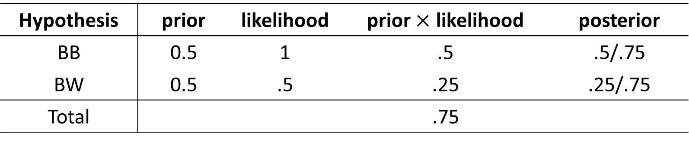
Bayes’ Box
We can now represent our calculation in a Bayes’ box:
Hypothesis | prior | likelihood | prior $×$ likelihood | posterior
BB | 0.5 | 1 | .5 | .5/.75
BW | 0.5 | .5 | .25 | .25/.75
Total |  |  | .75

Slide 49
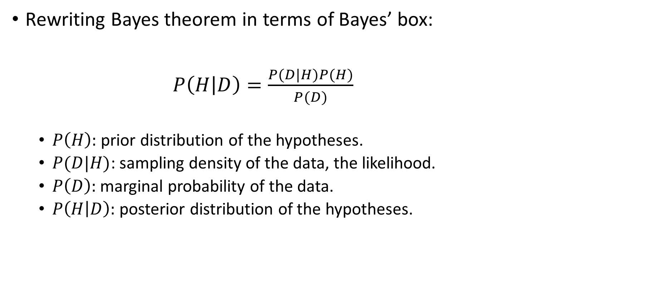
Bayes’ Box
Rewriting Bayes theorem in terms of Bayes’ box:
$P\left(H | D\right)=\frac{P(D|H)P(H)}{P(D)}$
$P\left(H\right):$ prior distribution of the hypotheses.
$P(D|H)$: sampling density of the data, the likelihood.
$P\left(D\right):$ marginal probability of the data.
$P\left(H | D\right):$ posterior distribution of the hypotheses.

Slide 50

Example
In 1995, the company that produce M&M chocolate introduced blue M&M’s. Before then, the color mix in a bag of M&M’s was 30% Brown, 20% Yellow, 20% Red, 10% Green, 10% Orange, 10% Tan. After 1995, it was 24% Blue , 20% Green, 16% Orange, 14% Yellow, 13% Red, 13% Brown.
Suppose Jack has two bags of M&M’s, and he tells you that one is from 1994 and one from 1996. He won’t tell you which is which, but he gives you one M&M from each bag. One is yellow and one is green. What is the probability that the yellow one came from the 1994 bag?

Slide 51
M&M
What if Jack gives you one brown M&M and one yellow M&M instead?

Slide 52

Example
You change your job and have a phone installed in your new office. You can’t remember the number but suspect it might be 555-3226. To test if this is the correct number, you carry out an experiment by picking up the phone and dialing 555-3226.
If you are correct about this phone number, you will definitely get a busy signal. If you are incorrect, the probability of getting a busy signal is 0.01. However, all of the above is only true if the phone is working. If the phone is broken, you will always get a busy signal.
David MacKay “Information Theory, Inference and Learning algorithm”

Slide 53
Example
When you do the experiment, you do actually get a busy signal. Lets consider the following 4 hypothesis and the corresponding probability:
H₁: The phone is working and the number is correct, P(H₁) = 0.4
H₂: The phone is working and the number is incorrect, P(H₂) = 0.4
H₃: The phone is broken and the number is correct, P(H₃) = 0.1
H₃: The phone is broken and the number is incorrect, P(H₄) = 0.1

Slide 54
Phone Example
Hypothesis | prior | likelihood | prior X likelihood | posterior
H₁
H₂
H₃
H₄
Total

Slide 55
Commercial Example
You have an oil company and your team have found a new field, Kekwa in East Malaysia. The geoscience team is confident that this field is worthy of further development. The commercial team is saying that the probability of this field being economically profitable, P[Kekwa Commercial] = 40%
The semi-submersible rig, Arbor 1, has been leased to drill a single appraisal well on Kekwa this year and these results will certainly provide a better indication of the economic potential of the structure. The reliability of this appraisal well is predicted by your team to be around 0.8, meaning that whatever the prognosis, there is an 80% probability that it is correct.
Find the probability of the field being uneconomic given the drilling is reliable.
Petroleum Economics, “Heriot-Watt University”

Slide 56
Medical Example
Suppose there is a new cancer tester in the market. There have been claims that the tester is able to give accurate predictions given the person having cancer by up to 90%. This means that the probability of the test showing a positive result for cancer when the patient really has cancer is 90%.
The probability of a population having cancer is 1%.
What is the probability of someone not having cancer but he is tested positive for it ?

Slide 57
Bayesian Inference
An important part of Bayesian inference is the establishment of parameters and models.
Models: the mathematical formulation of the observed events.
Parameters: the factors in the models affecting the observed data.

Slide 58

Mathematical Model
Example: The Normal distribution
$$f\left(x\right)=\frac{1}{σ\sqrt{2π}}exp\left({−\frac{1}{2}\left[\frac{x−μ}{σ}\right]}^{2}\right)$$
Parameters:

Slide 59
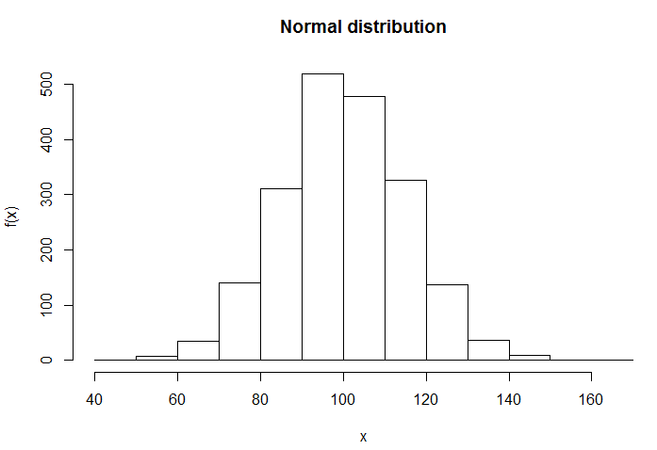
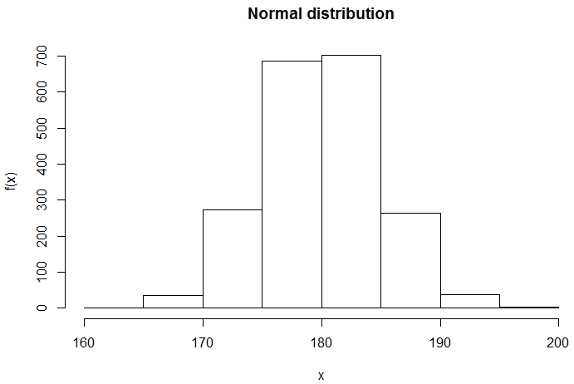
Normal Distribution

Slide 60

Mathematical Model
Example: The Beta distribution
$$f\left(x\right)=\frac{x^{α−1}×{\left(1−x\right)}^{β−1}}{B(α,β)}$$
Parameters:

Slide 61
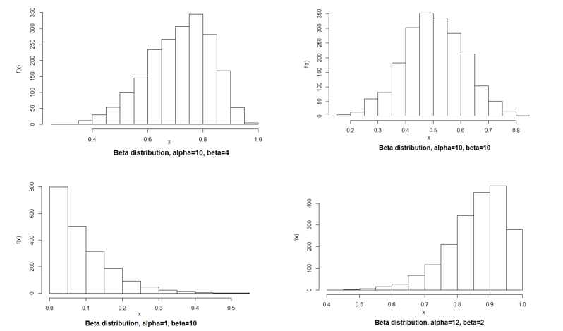
Beta Distribution

Slide 62
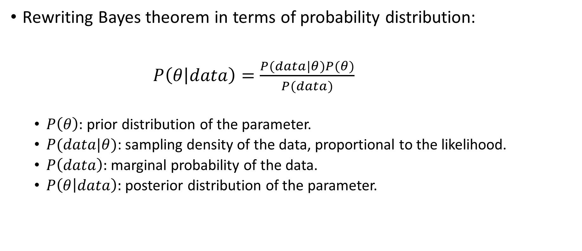
Bayesian Inference
Rewriting Bayes theorem in terms of probability distribution:
$P\left(θ | data\right)=\frac{P(data|θ)P(θ)}{P(data)}$
$P\left(θ\right):$ prior distribution of the parameter.
$P(data|θ)$: sampling density of the data, proportional to the likelihood.
$P\left(data\right):$ marginal probability of the data.
$P\left(θ | data\right):$ posterior distribution of the parameter.

Slide 63
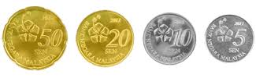
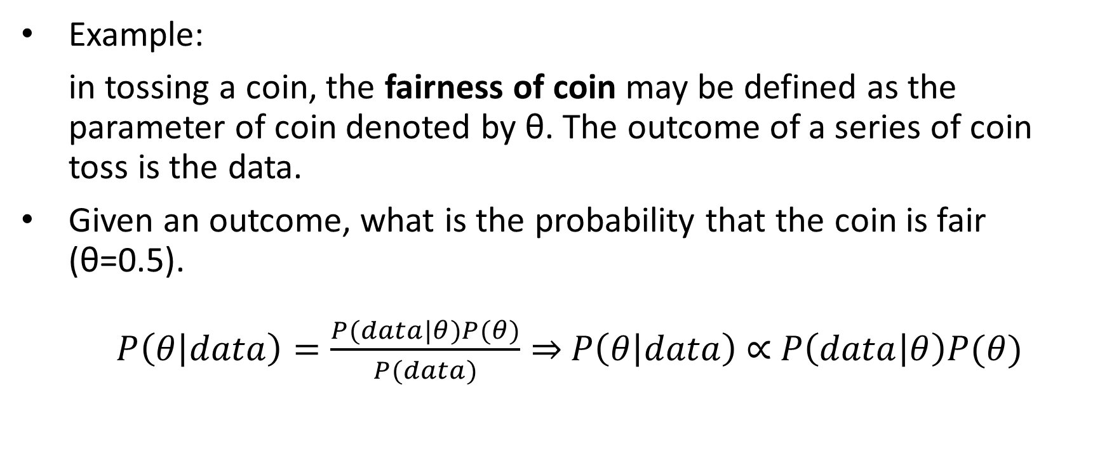
Bayesian Inference
Example:
in tossing a coin, the fairness of coin may be defined as the parameter of coin denoted by θ. The outcome of a series of coin toss is the data.
Given an outcome, what is the probability that the coin is fair (θ=0.5).
$P\left(θ | data\right)=\frac{P(data|θ)P(θ)}{P(data)}⇒$ $P\left(θ | data\right)$ $∝$ $P\left(data | θ\right)P(θ)$

Slide 64
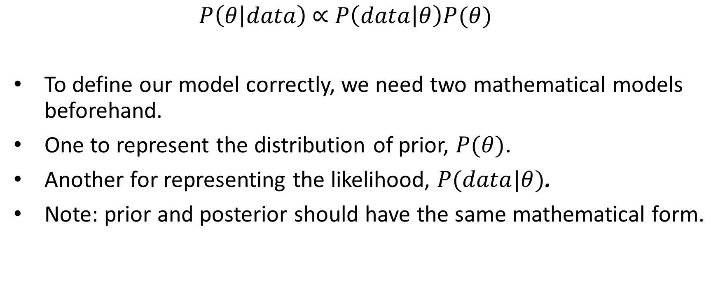
Fairness of Coin
$P\left(θ | data\right)$ $∝$ $P\left(data | θ\right)P(θ)$
To define our model correctly, we need two mathematical models beforehand.
One to represent the distribution of prior, $P(θ)$.
Another for representing the likelihood, $P(data|θ)$.
Note: prior and posterior should have the same mathematical form.

Slide 65
Fairness of Coin - Likelihood
Likelihood: the probability of observing a particular number of heads in a particular number of flips for a given fairness of coin.
The probability of observing heads/tails depends upon the fairness of coin (θ).
If we toss a coin 1 time, what is the probability of observing a head?

Slide 66
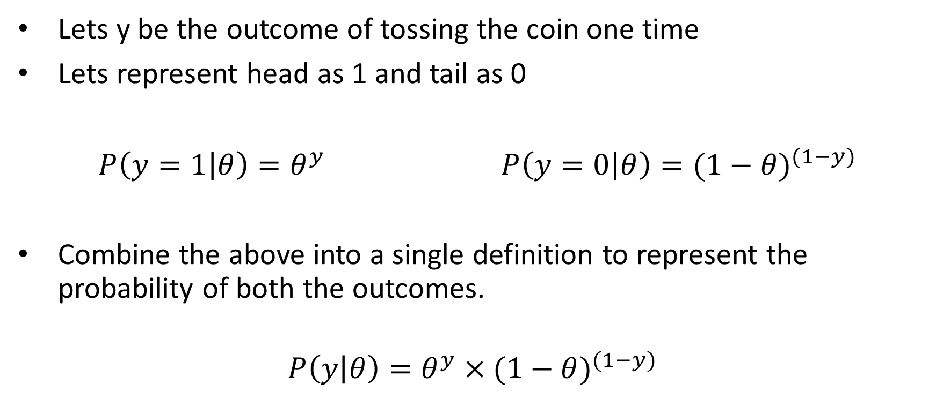
Fairness of Coin - Bernoulli Likelihood
Lets y be the outcome of tossing the coin one time
Lets represent head as 1 and tail as 0
$P\left(y=1 | θ\right)=θ^{y}$ $P\left(y=0 | θ\right)={(1−θ)}^{(1−y)}$
Combine the above into a single definition to represent the probability of both the outcomes.
$$P\left(y | θ\right)=θ^{y}×{(1−θ)}^{(1−y)}$$

Slide 67
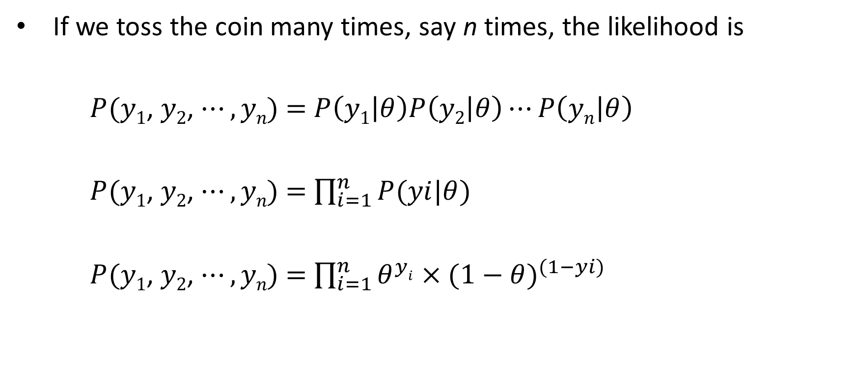
Fairness of Coin - Binomial Likelihood
If we toss the coin many times, say n times, the likelihood is
$P(y1$, $y2$, $⋯,yn\text{) =}$ $P\left(y1 | θ\right)P\left(y2 | θ\right)⋯P\left(yn | θ\right)$
$P(y1$, $y2$, $⋯,yn\text{) =}$ $\prod_{i=1}^{n}{P(yi|θ)}$
$P(y1$, $y2$, $⋯,yn\text{) =}$ $\prod_{i=1}^{n}{θ^{yi}×{(1−θ)}^{(1−yi)}}$

Slide 68

Fairness of Coin - Binomial Likelihood
If we are interested in the probability of getting k heads in N number of toss then the probability is given by:
$$P\left(k,N | θ\right)=θ^{k}×{(1−θ)}^{(N−k)}$$

Slide 69
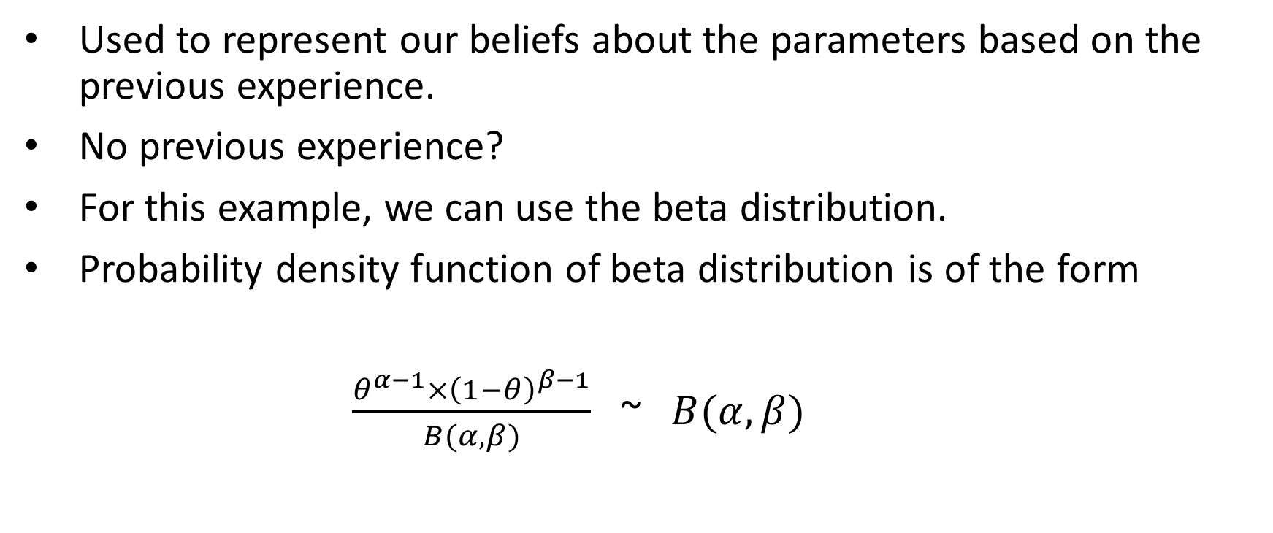
Fairness of Coin – Prior distribution
Used to represent our beliefs about the parameters based on the previous experience.
No previous experience?
For this example, we can use the beta distribution.
Probability density function of beta distribution is of the form
$\frac{θ^{α−1}×{\left(1−θ\right)}^{β−1}}{B(α,β)}$ ~ $B(α,β)$

Slide 70
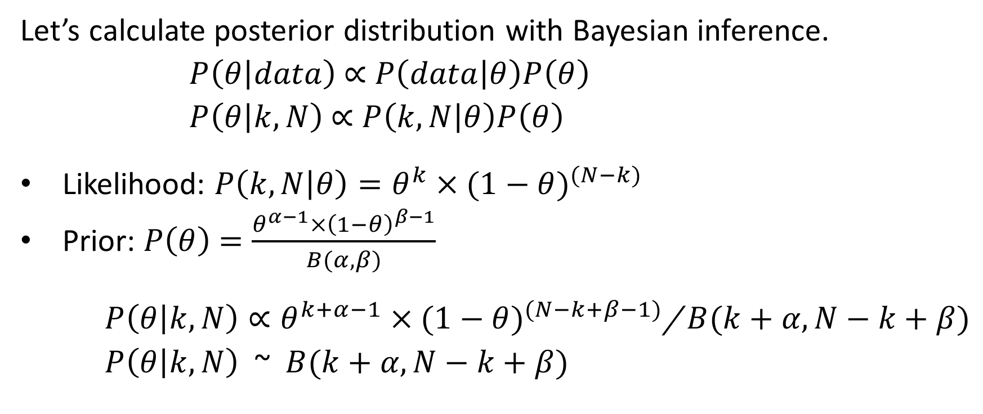
Fairness of Coin – Posterior distribution
Let’s calculate posterior distribution with Bayesian inference.
$P\left(θ | data\right)$ $∝$ $P\left(data | θ\right)P\left(θ\right)$
$P\left(θ | k,N\right)$ $∝$ $P\left(k,N | θ\right)P\left(θ\right)$
Likelihood: $P\left(k,N | θ\right)=θ^{k}×{(1−θ)}^{(N−k)}$
Prior: $P\left(θ\right)$ $=\frac{θ^{α−1}×{\left(1−θ\right)}^{β−1}}{B(α,β)}$
$P\left(θ | k,N\right)∝θ^{k+α−1}×{(1−θ)}^{(N−k+β−1)}$/ $B(k+α,N−k+β)$
$P\left(θ | k,N\right)$ ~ $B(k+α,N−k+β)$

Slide 71
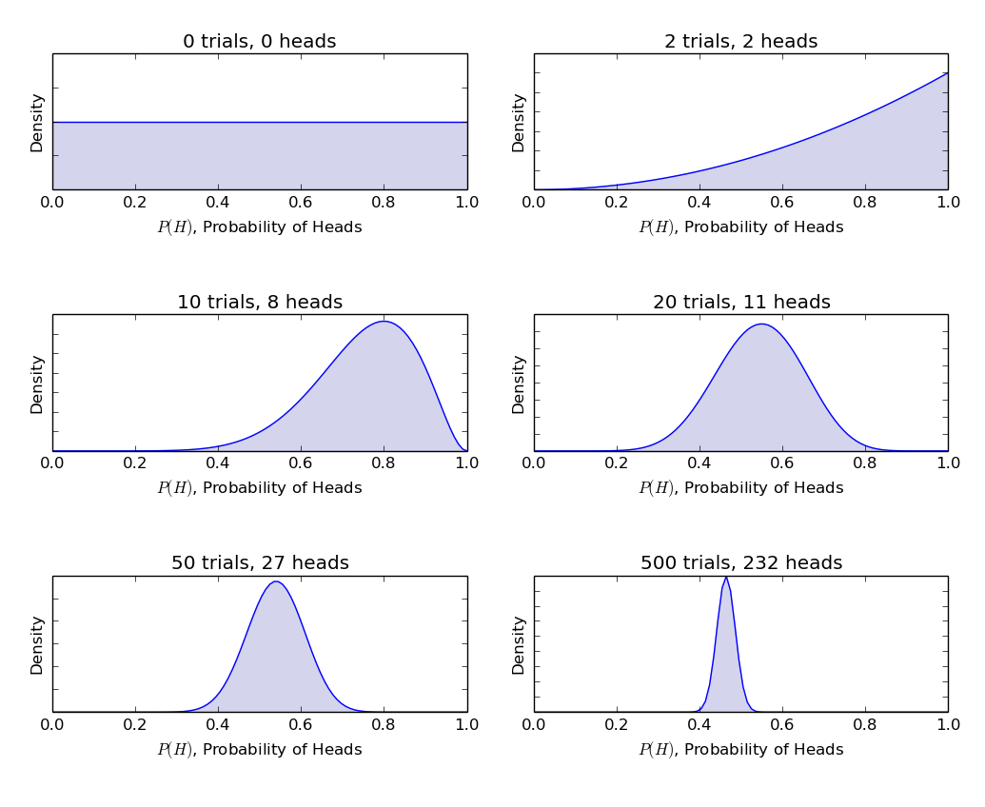
Fairness of Coin

Slide 72
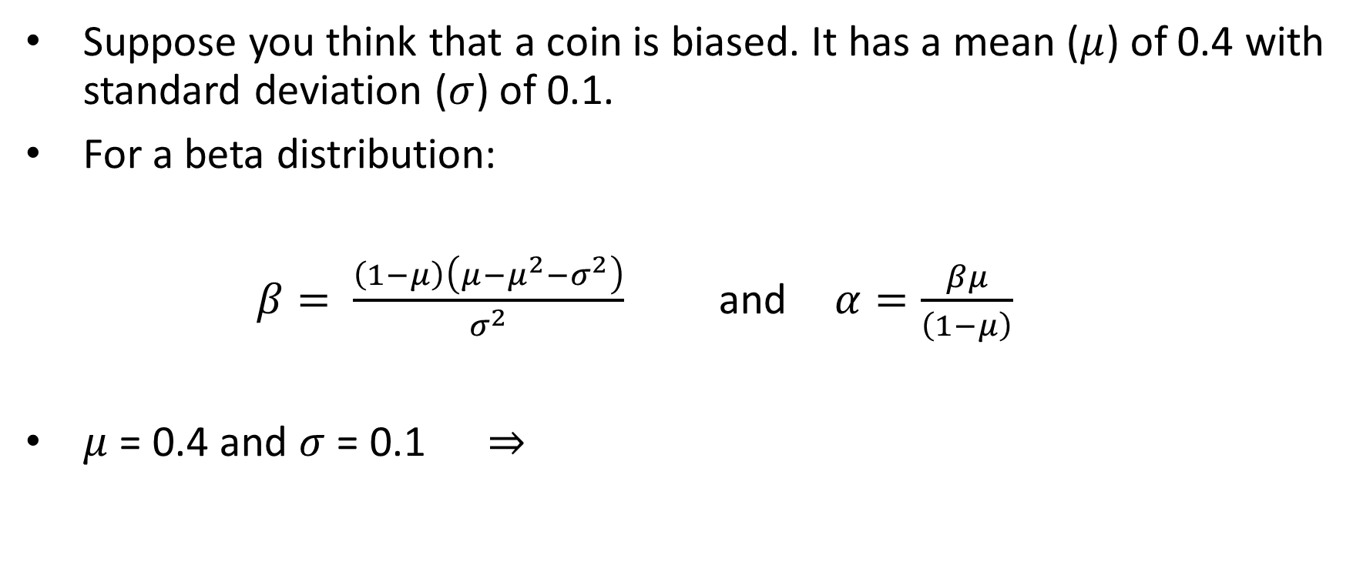
Fairness of Coin
Suppose you think that a coin is biased. It has a mean ($μ$) of 0.4 with standard deviation ($σ$) of 0.1.
For a beta distribution:
$β= \frac{\left(1−μ\right)\left(μ−μ^{2}−σ^{2}\right)}{σ^{2}}$ and $α=\frac{βμ}{\left(1−μ\right)}$
$μ$ = 0.4 and $σ$ = 0.1 $⇒$

Slide 73
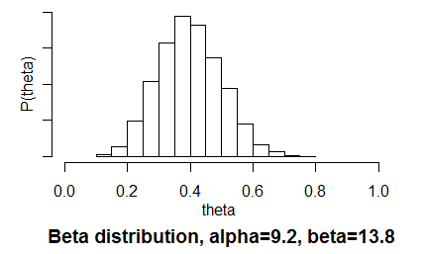
Prior Distribution

Slide 74
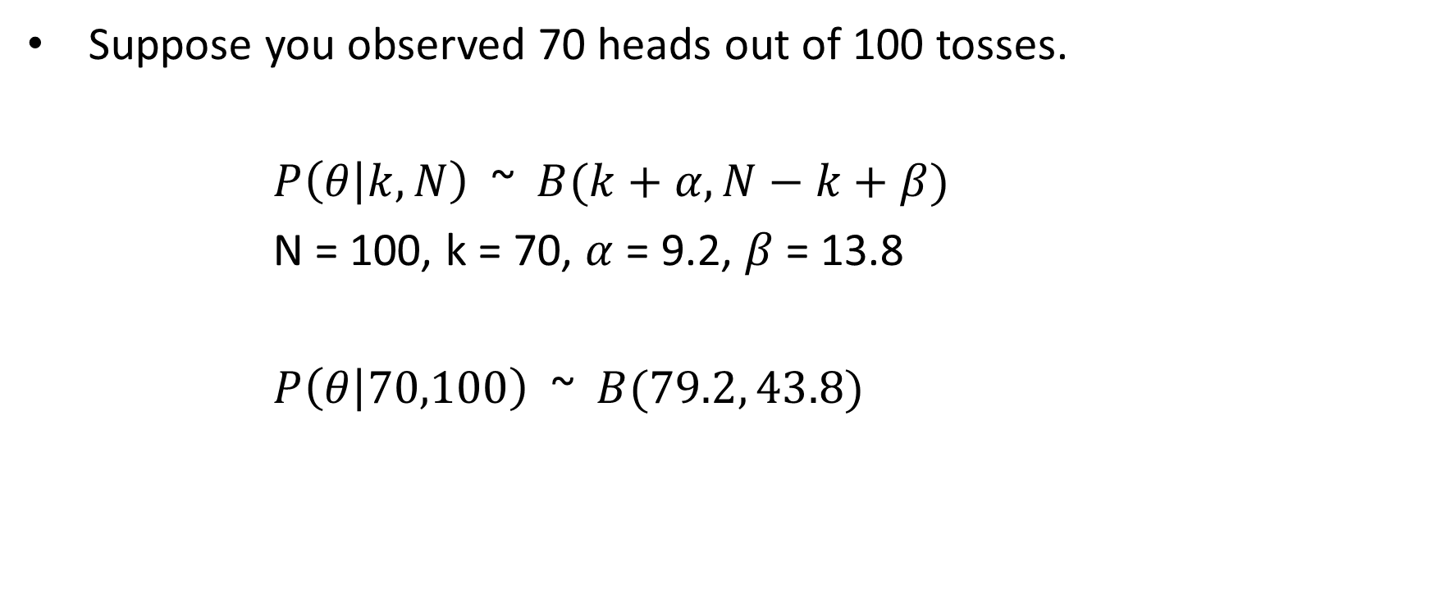
Fairness of Coin
Suppose you observed 70 heads out of 100 tosses.
$P\left(θ | k,N\right)$ ~ $B(k+α,N−k+β)$
N = 100, k = 70, $α$ = 9.2, $β$ = 13.8
$P\left(θ | 70,100\right)$ ~ $B(79.2, 43.8)$

Slide 75
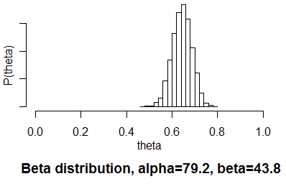
Posterior Distribution

Slide 76
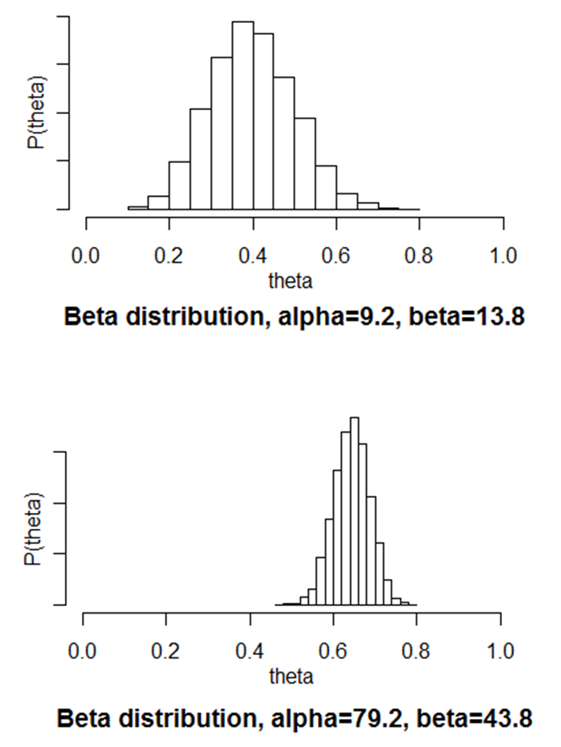

Bayesian Inference
As more and more tosses of coins made
$⇒$ new data is observed
$⇒$ distribution of parameters get updated.

Slide 77
Prior in Bayesian Inference
Previous studies or published work.
Researcher intuition.
Substantive experts.
Convenience (conjugacy, vagueness).
Nonparametrics.
Other data sources.

Slide 78
The Frequentist paradigm
Defines probability as a long-run frequency on independent identical trials.
Looks at parameters as fixed quantities. (fixed sample size, fixed intention, probability of a coin toss, etc)

Slide 79
The Bayesian paradigm
Defines probability as a subjective belief (which must be consistent with all of one’s other beliefs).
Looks at parameters as random quantities.

Slide 80
Differences Between Bayesians and Non-Bayesians
What is Fixed?
Frequentist:
Data are a repeatable random sample, there is a frequency.
Underlying parameters remain constant during this repeatable process.
Parameters are fixed.
Bayesian:
Data are observed from the realized sample.
Parameters are unknown and described probabilistically.
Data are fixed.

Slide 81
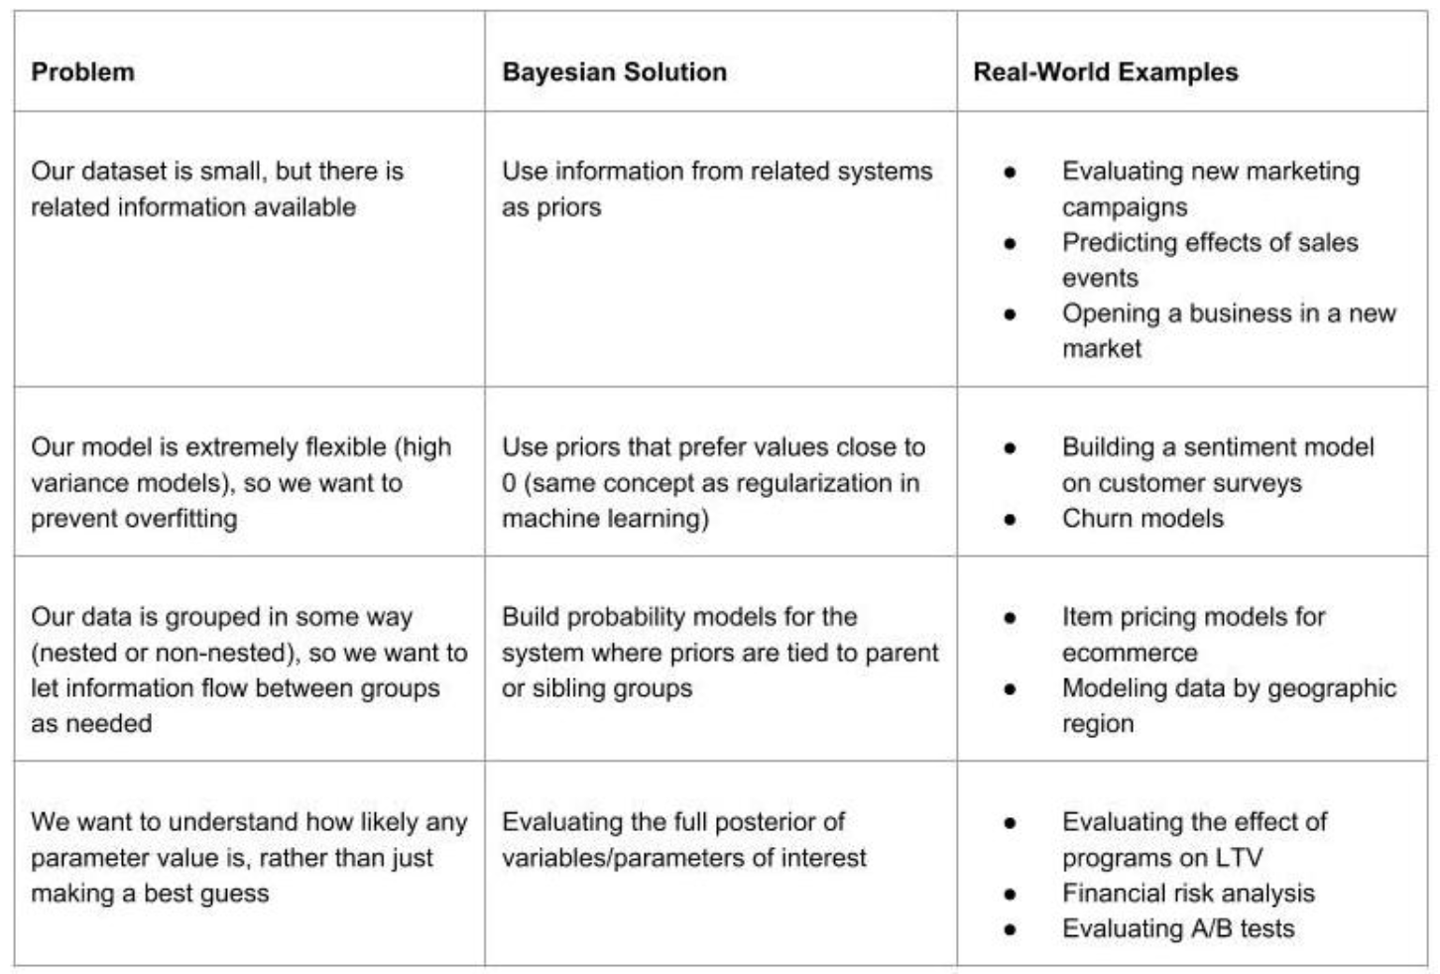
Bayesian Application

Slide 82
Other topics in Bayesian
Credible interval
Hypothesis testing and model selection
Bayes factor
Bayesian modelling
Computational techniques
Regression
And many others

Slide 83
The End

